Slide 1

BAYWATCH
ECURIOUS CHALLENGE · SMART RESERVATION FOR EV CHARGING
Reserve digitally.
Access physically.
INTEGRATED IN ECURIOUS · GOINGELECTRIC DATA

Slide 2
THE EV WAVE IS HERE
THE MARKET · GERMANY
2.0M
204K
battery-electric cars on German roads
public charging points, +17% in a year
$2.1B
$15.1B
total German EV charging market, 2025
projected market size by 2034, about 24% growth a year
≈ 10 EVs share every public charge point. Every bay has to work harder.
Sources: KBA (Jan 2026), Bundesnetzagentur (May 2026), IMARC Group (market size). Ratio: our calculation.
02 / 16

Slide 3
YOU ARRIVE. THE BAY IS TAKEN.
THE PROBLEM
45%
Today a charger app can tell you a bay is free, but nothing keeps it free until you get there.
of European EV drivers say a charger occupied by another vehicle is one of their biggest problems.
Source: Parkopedia European Driver Survey 2024 (2,440 respondents, incl. 1,220 EV drivers).
03 / 16

Slide 4
EVERYONE LOSES
THE IMPACT
DRIVERS
CHARGE-POINT OPERATORS
THE EV TRANSITION
DETOURS, WAITING, RANGE STRESS
IDLE BAYS, LOST SESSIONS
CHARGER ANXIETY
The majority of EV drivers wait for a public charger at least 1 in 5 times.
A booking only has value if the bay is really free when you arrive.
Source: CTEK / YouGov EV survey 2023, five European countries.
04 / 16

Slide 5

MEET BAYWATCH
OUR SOLUTION
BOOKED BY YOU
Reserve a bay in the app. The bay is secured until you arrive.
TEST BAY
WEB APP TODAY · SOON IN ALL APP STORES
Today · 18:00–20:00
M-XX 1234
GUARANTEED BAY
YOUR PLATE IS THE KEY
FAIR RULES
Hardware keeps it free
For no-shows and blockers
Camera opens the bay
Navigate to bay
POWERED BY ECURIOUS
05 / 16

Slide 6
FIVE STEPS, ZERO GUESSWORK
HOW IT WORKS
01
02
03
04
05
RESERVE
HOLD
ARRIVE
CHARGE
RELEASE
Camera reads your plate, the bay opens.
Pick a bay and slot in the app, pay the fee.
Ecurious hardware keeps the bay free.
Plug in at the charger as usual.
Bay detected clear, the next driver is in.
Camera trouble? Manual unlock in the app.
APP
ECURIOUS SERVER
BAY + CAMERA
Enter your details and licence plate once, then book and pay
→
Sends hold and open commands. Compliant with EU data protection law (GDPR).
→
The gate recognises your plate and opens the bay
Charger data from GoingElectric.
06 / 16

Slide 7
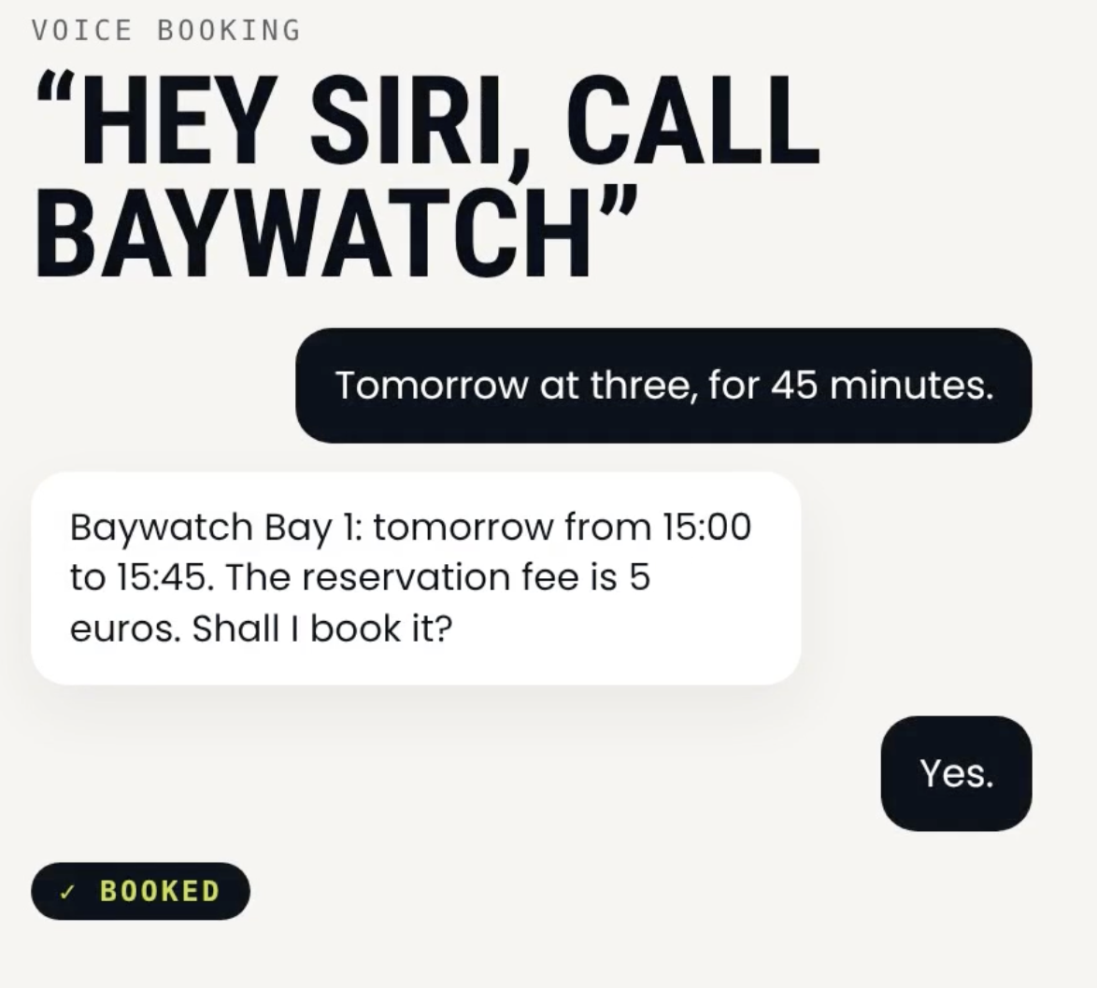
ON THE ROAD AND THINGS COME UP?
BAYWATCH AI
BayWatch AI is only one call away.
“CANCEL MY BOOKING”
“FIND ME A BAY”
“YOUR BAY ISN’T FREE”
CANCEL
BOOK
REROUTE
Plans changed? Cancel by phone, the bay goes back to others.
Make a new booking hands-free, without opening the app.
Your spot is unavailable due to an error? We call you in time and reroute you to the next free bay.
07 / 16

Slide 8
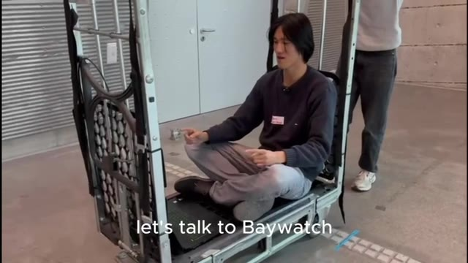
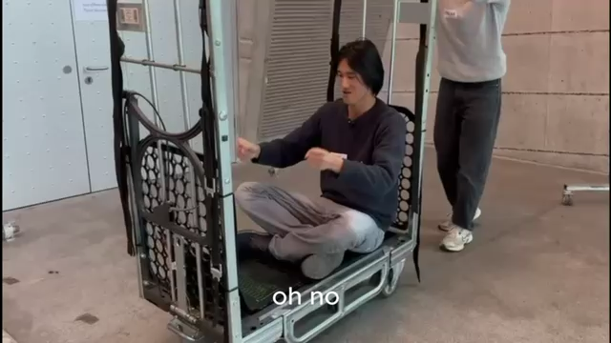
DEMO VIDEO
RESERVE → PLATE CHECK → BAY OPENS → CHARGE → RELEASE
08 / 16

Slide 9
CANCEL EARLY, PAY LESS
SOLVING NO-SHOWS
100%
80%
50%
25%
0%
>24 H BEFORE
24 H – 2 H
2 H – 30 MIN
<30 MIN
NO-SHOW
€0 kept
€1.25 kept
€2.50 kept
€4.00 kept
€5.00 kept
Reminders at 24 h, 2 h, 30 min and 5 min. Drivers cancel in time, bays go back to others.
Share of a €5 booking kept by BayWatch, never an extra penalty. Proposed pilot rules.
09 / 16

Slide 10
BLOCKED? WE’VE GOT YOU.
SOLVING BLOCKED BAYS
BAY BLOCKED BEFORE YOU ARRIVE
DRIVER OVERSTAYS
CAMERA SPOTS IT
REMINDER 5 MIN BEFORE
YOU GET A CALL
5 MIN GRACE
REROUTE 10 MIN EARLY
THEN €0.30 / MIN PENALTY
+ €5 CREDIT
Credit applies for a reroute longer than 200 m.
Blocking fee shared 50/50 with the operator.
Proposed policy: credit, fee and revenue split to be agreed with operators.
10 / 16

Slide 11
MORE CHARGING, SAME BAYS
MORE UTILISATION
€0
€3–6
WALK-UP ACCESS
PREDICTIVE RESERVATION PRICING
Empty bays open to anyone, no fee. Every walk-up driver meets the app.
The reservation fee is cheaper at quiet times and higher at peaks. Demand spreads out.
FUTURE PERSPECTIVE
Partner deals with e-taxi services and office fleets.
Pricing range is tested in the 90-day pilot.
11 / 16

Slide 12
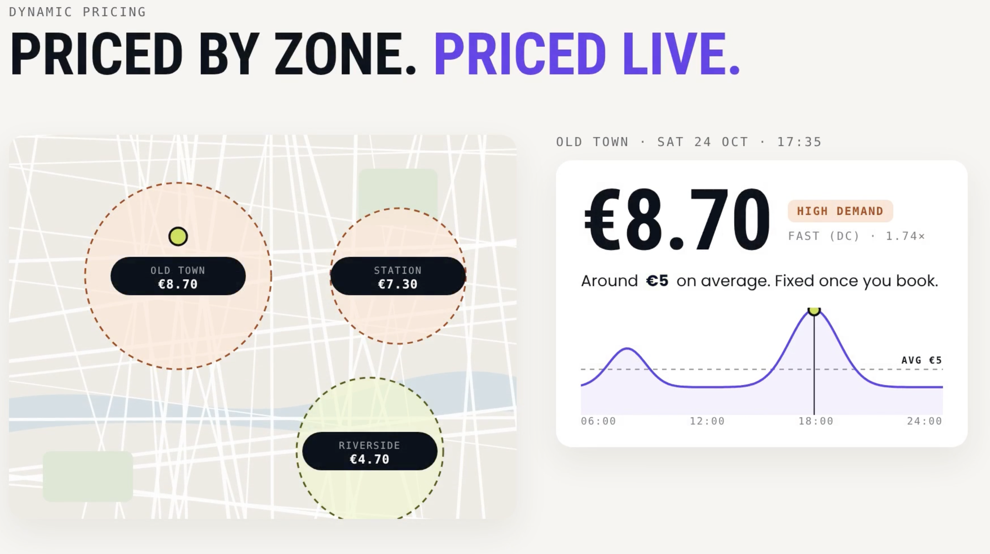
HOW WE MAKE MONEY
BUSINESS MODEL
DYNAMIC PRICING
RESERVATION FEES
FAST · 1 HOUR
€3
PLUS
FAST · 2 HOURS
€5
No-show & late-cancel fees
Blocking fees, 50/50 with operators
Fleet deals for quiet bays
SLOW · 4 HOURS
€4
Charging commission of 1–5%
Electricity is billed separately at the charger.
20%
Next: dynamic pricing that adapts these fees to demand.
of net reservation revenue goes to the bay owner
Proposed pilot prices; subject to change after the pilot.
12 / 16

Slide 13
BREAK EVEN IN 67 BOOKINGS
UNIT ECONOMICS
DRIVER PAYS
19% VAT
PAYMENT FEE
OWNER 20%
WE KEEP
€5.00
−€0.80
−€0.33
−€0.84
€3.03
€200
14 DAYS
our cost per bay: €50 hardware + €150 installation and maintenance
at 5 bookings a day
FUTURE PERSPECTIVE
Monthly subscription with booking credits to cut transaction fees.
€200 setup per bay, Stripe EEA card fee. Excludes other operating costs; illustrative, not a guarantee.
13 / 16

Slide 14
THERE’S MORE
FUTURE INTEGRATION
Complete documentation of our API and SDK, so third-party apps can integrate our services.
API
SDK
FOR OPERATORS & PLATFORMS
FOR APP DEVELOPERS
Check live bay status, book and release bays straight from their own systems. Open and OCPI-ready.
Drop BayWatch booking, plate check and unlock into their own mobile apps.
14 / 16

Slide 15
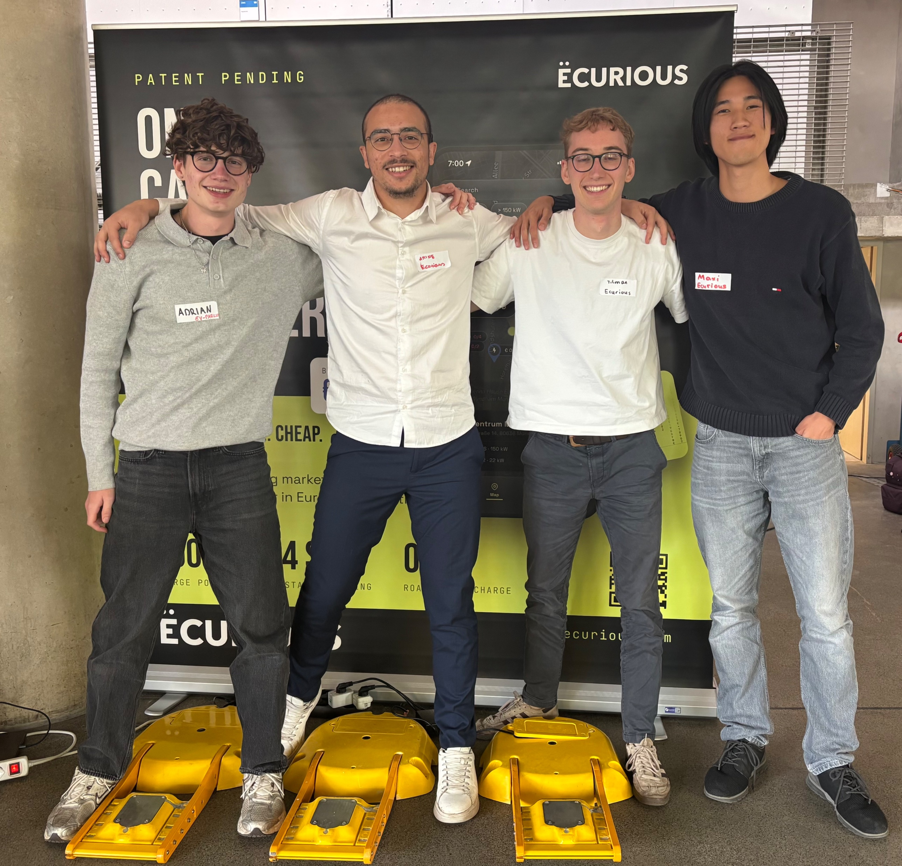
THE PEOPLE BEHIND BAYWATCH
THE TEAM
ADRIAN · AMINE · TILMAN · MAXI
15 / 16

Slide 16
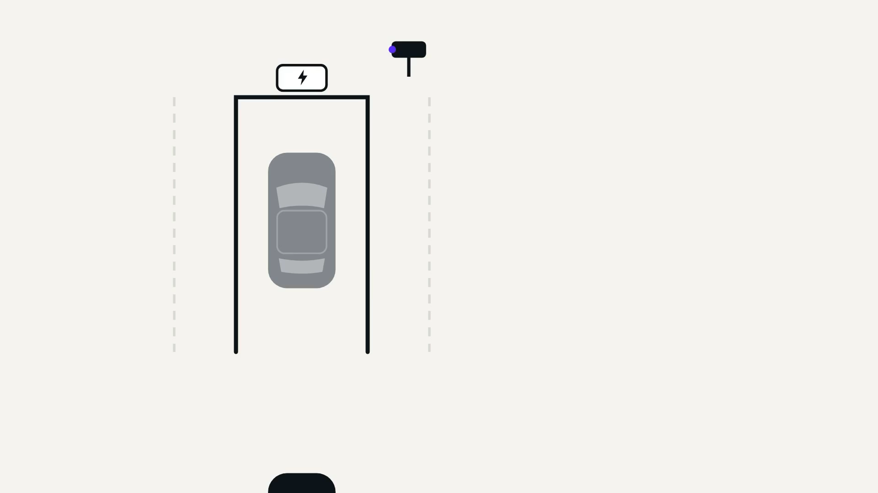
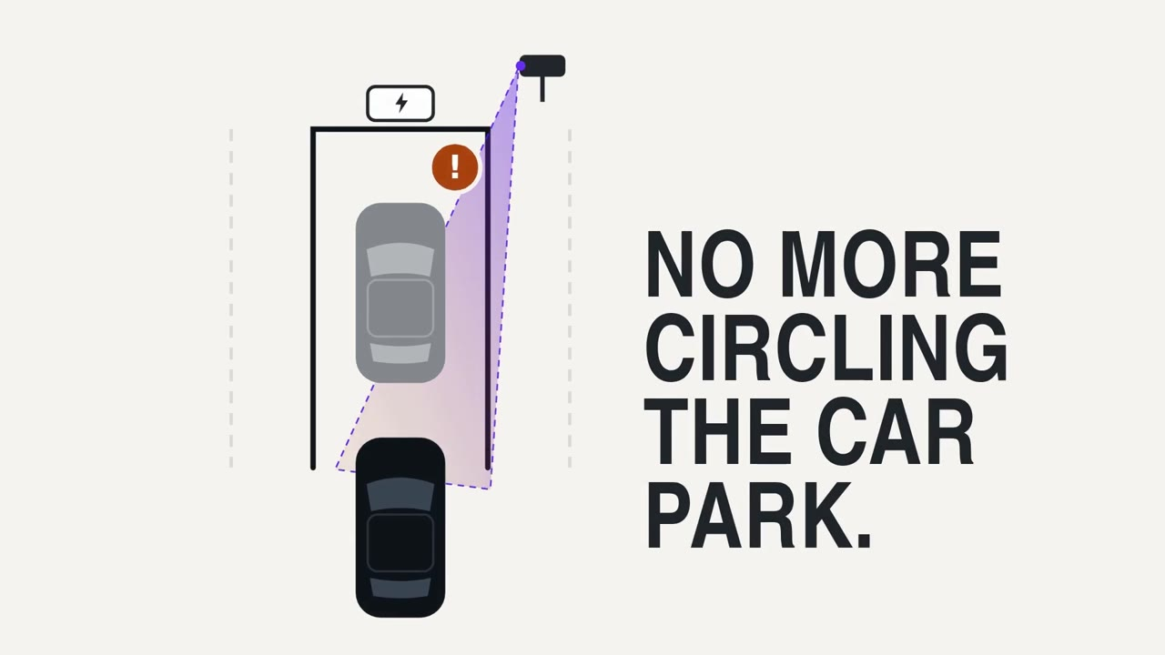
THANK YOU
BAYWATCH · POWERED BY ECURIOUS
Book your spot. Arrive with confidence.
Charge without the uncertainty.
QUESTIONS? · GITHUB.COM/MOHAMEDAMINEHAMDI/BAYWATCH

